Slide 1
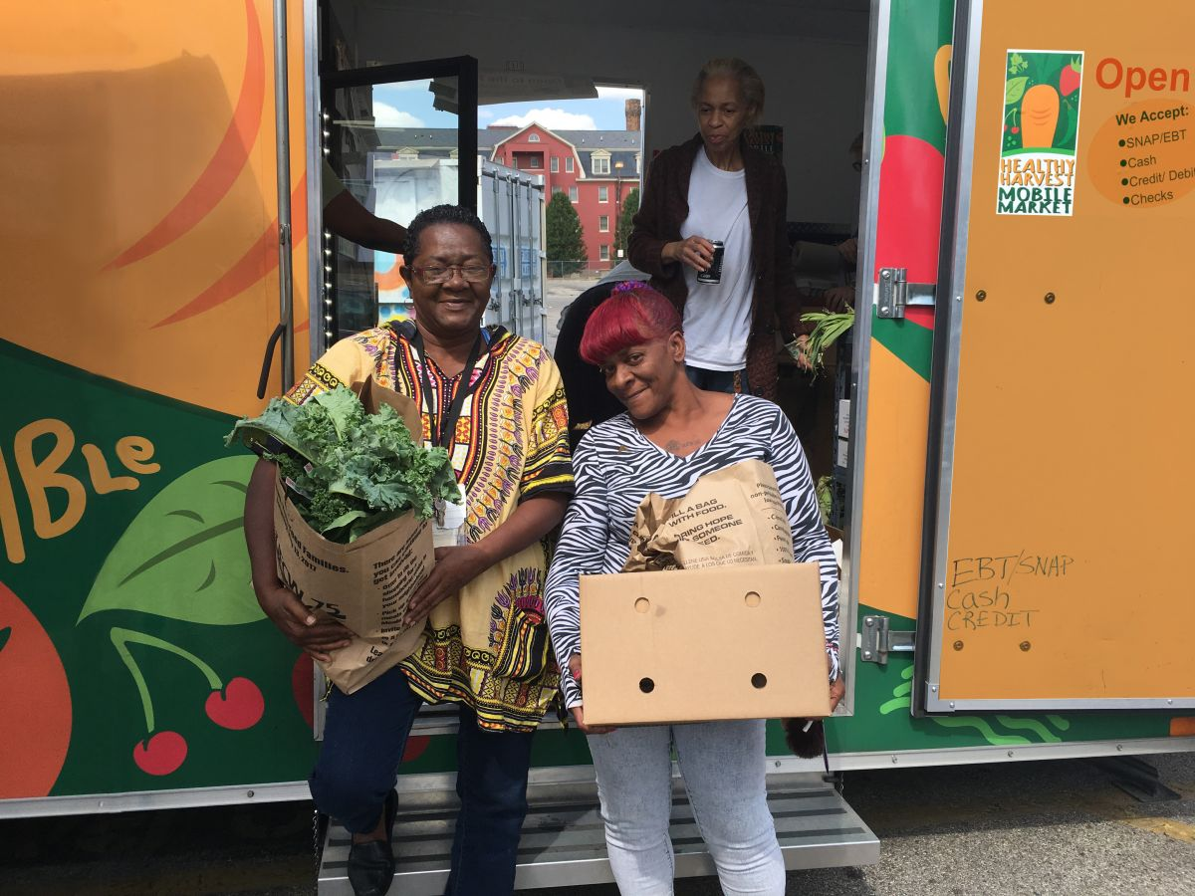

Service & Advocacy in Walnut Hills
Tackling food insecurity from many angles
Notes:
Hello! And thanks for your interest in my work with the Service and Advocacy Elective. I focused my efforts in Walnut HIlls, mostly working to reduce food insecurity in the neighborhood.

Slide 2

Meet Walnut Hills
1
Notes:
If you’re not familiar with Walnut Hills, let me introduce you.

Slide 3
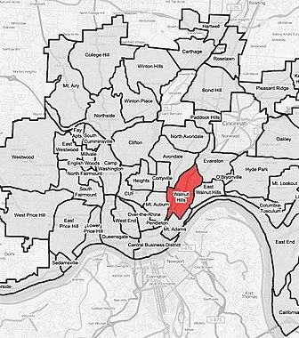
INTRODUCTIONS
Walnut Hills is a majority-Black neighborhood about 2 miles northeast of downtown. It has:
One of the highest rates of chronic disease, poverty and food insecurity
One of the lowest life expectancies
Thriving network of non-profit organizations and neighbor volunteers
Notes:
I first connected with the people of Walnut Hills in the spring of 2022, through my work with UCCOM’s Food Insecurity Collaborative. - SLIDE

Slide 4




Service Partners
INTRODUCTIONS
The Church of the Advent
An inclusive, diverse Episcopal church with a food pantry and community garden.
Walnut Hills Area Council
A group of engaged WH residents representing Walnut Hills at the city level.
Walnut Hills Redevelopment Foundation
A non-profit community development corporation working to enhance quality of life in WH.
Black Power Initiative
A community-based non-profit working toward equity through education and food programs.
Notes:
While many of my peers partnered with a specific organization, Walnut Hills’ community groups work so seamlessly together, that I actually worked with several. I was familiar with most of the organizations from my previous food insecurity work in the neighborhood and so I was able to deepen those existing relationships.

Slide 5
Service Work
1
Distributed food at events hosted by BPI and WHRF
2
Grew, harvested and prepared produce at gardens run by WHRF and COTA
3
Created marketing materials for clothing drives and events offered by WHAC partners
4
Wrote a Letter of Intent for grant funding to support WHAC’s community health worker training program
Notes:
For the service portion of my work, I - SLIDE

Slide 6




LESSONS LEARNED
CULTURAL RELEVANCE
FOOD AS COMMUNITY
To truly reduce food inequity, neighbors must have access to food that fits their lifestyle and their cultural needs.
Events like Friday Food & Fun and the chance to enjoy coffee at the food pantry strengthen the community.
PIPELINE TO HEALTH
COLLABORATION
Food events draw people in and are a wonderful opportunity to provide access to other services like screenings, pharmacy information, etc.
The interconnectedness of Walnut Hills’ organizations helps them all make a bigger impact in the community.
Notes:
Through this work, I learned

Slide 7
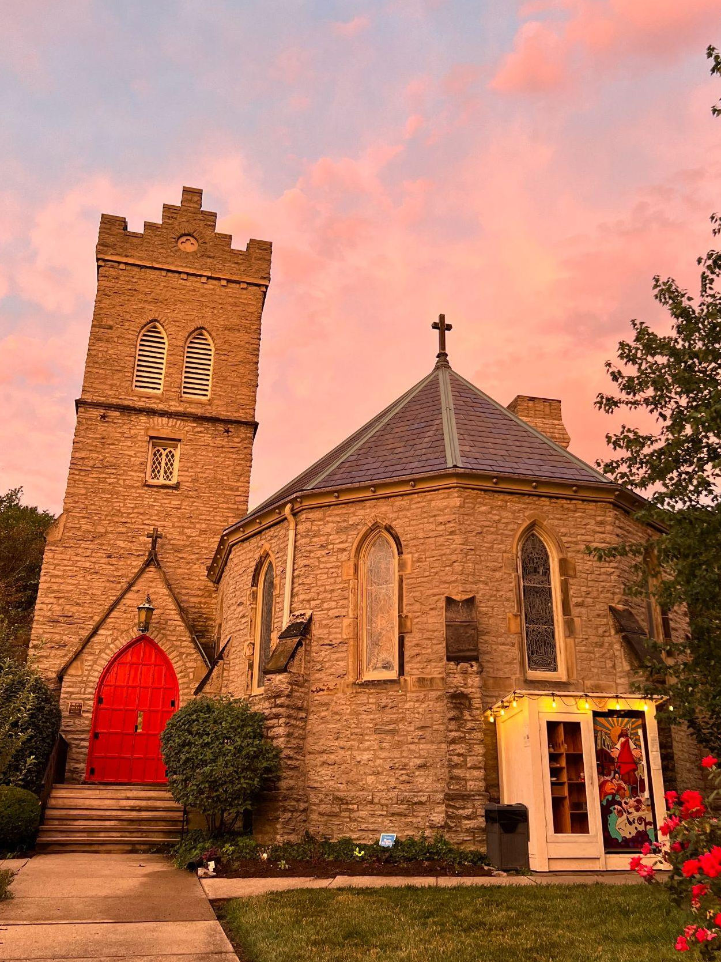
Project Partner
INTRODUCTIONS
The Church of the Advent is an 170-year-old Episcopal congregation committed to reducing inequity in Walnut Hills through:
Service
Open Door Food Pantry and
Free Fridge
Good News Community Garden
Notes:
While I worked with multiple organizations over this past year, the majority of my project was done in partnership with The Church of the Advent.

Slide 8

Project
Roadmap

Slide 9
Challenges Faced
PROJECT
1
Open Door Pantry needs more funding to keep up with current and increasing demand
2
Good News Garden requires clearer direction to supplement pantry
3
Seasonal overabundance of specific garden produce often results in food waste
4
Recent grant applications did not result in awarded funds
Notes:
In getting to know the outreach efforts and staff members at Church of the Advent, I learned some of the barriers they faced while working to improve quality of life in Walnut HIlls.

Slide 10
Project Approach
PROJECT
I collaborated closely with COTA Grants Committee and the Ministers of Land and Food Justice, Megan and Junae, to implement a project plan.
I then completed the audit, wrote and administered the survey, and analyzed and presented the data back to the COTA team.
1
Audit previous grant applications to find opportunities to strengthen future grants and make applying simpler
2
Survey Open Door Pantry guests to gather data that improves grants and directs garden seed selection
3
3
Leverage survey responses to identify next steps and future projects
Notes:
Knowing the barriers, I worked with COTA staff to create a 3-part project plan. - SLIDE with more details

Slide 11
PROJECT
GRANT AUDIT FINDINGS: DATA GAPS
Disability data for people served
Number of church member volunteers
Number of people served (directly or indirectly) by pantry and garden
Social isolation of guests/neighborhood
Number of nearby parks
Food insecurity in neighborhood
Size of food desert
Number of nearby playgrounds
Weight/volume of donated food
Weight/volume of garden grown food for pantry/fridge
Number of people accessing free fridge
Number of other local food pantries
Demographics of congregation
Notes:
These are the gaps I identified while auditing COTA’s previous grant applications.

Slide 12
Survey
We collected information from 16 guests of the Open Door Food Pantry, in late January. Not all guests answered all questions, but all guests provided recommendations for produce they’d like to see in the pantry and garden.
The goals of the survey were to:
Strengthen understanding of who is served at the Open Door Pantry in order to improve grant applications.
Identify what vegetables/produce guests want to guide garden planning for the 2025 season and beyond.
Understand whether unfamiliarity with vegetables/produce prevents guests from choosing them.
Gauge guest interest in participating in produce prep and gardening.
Notes:
Part 2 of the project was to survey guests using the Open Door Food Pantry.

Slide 13
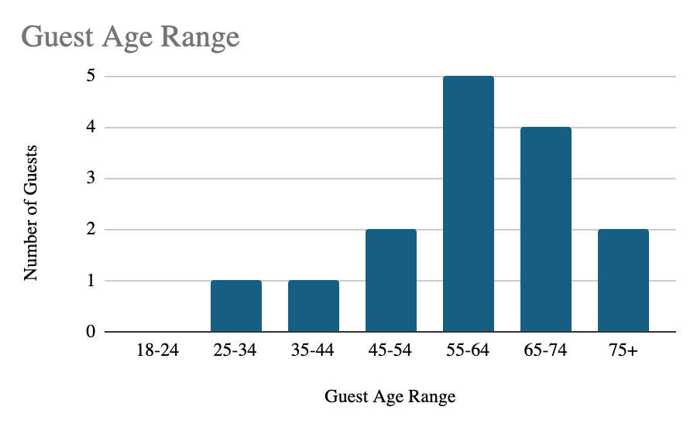
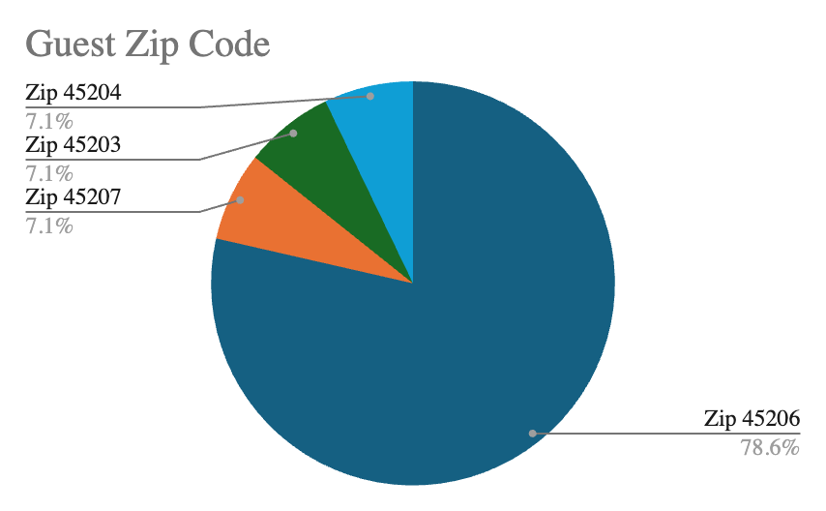
Survey Results
Guests ranged from 29-87 years old, with a heavy concentration over 55. The vast majority of guests live in Walnut Hills, with a small number traveling from nearby neighborhoods.

Slide 14
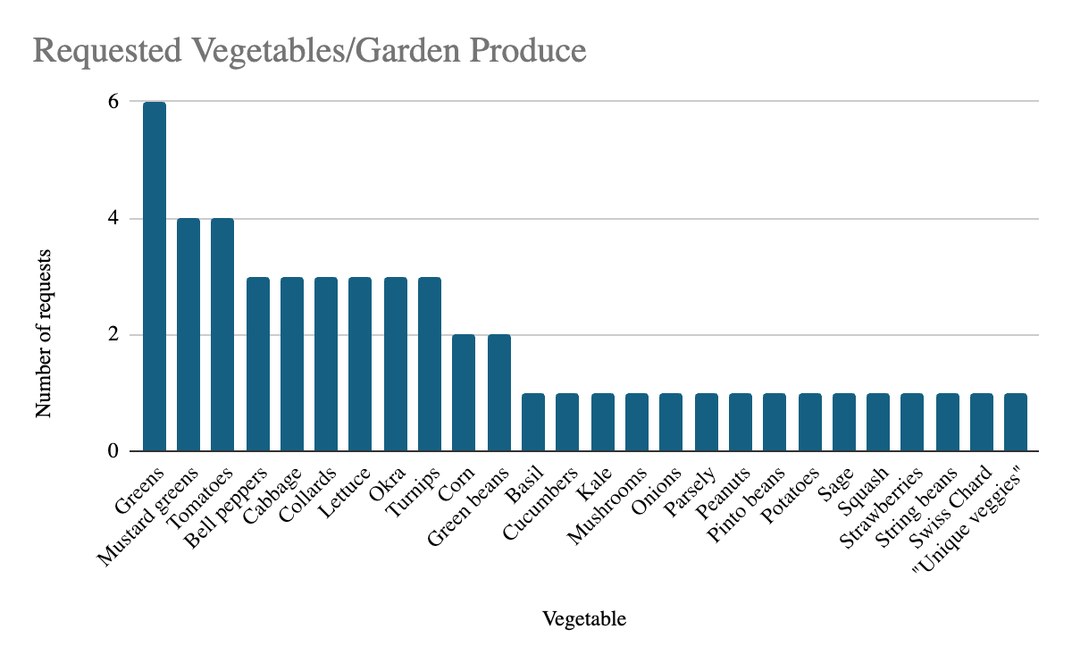
Survey Results
All respondents had suggestions for produce they would like to see in the food pantry.

Slide 15
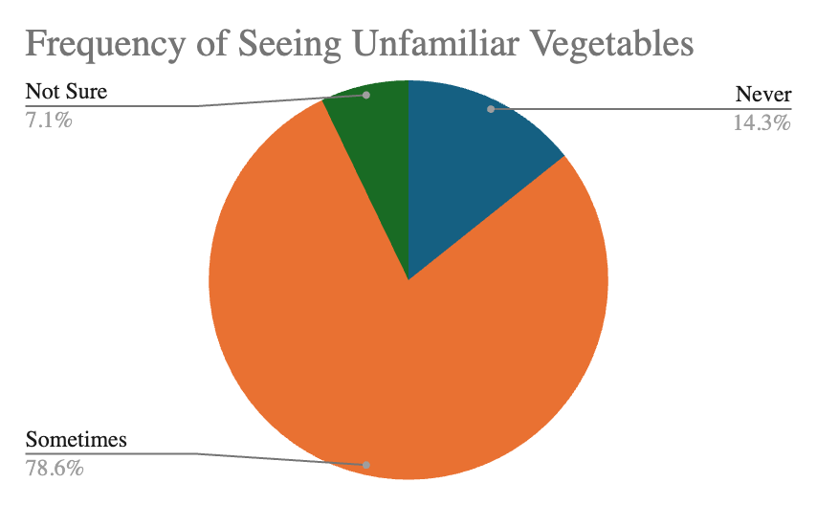
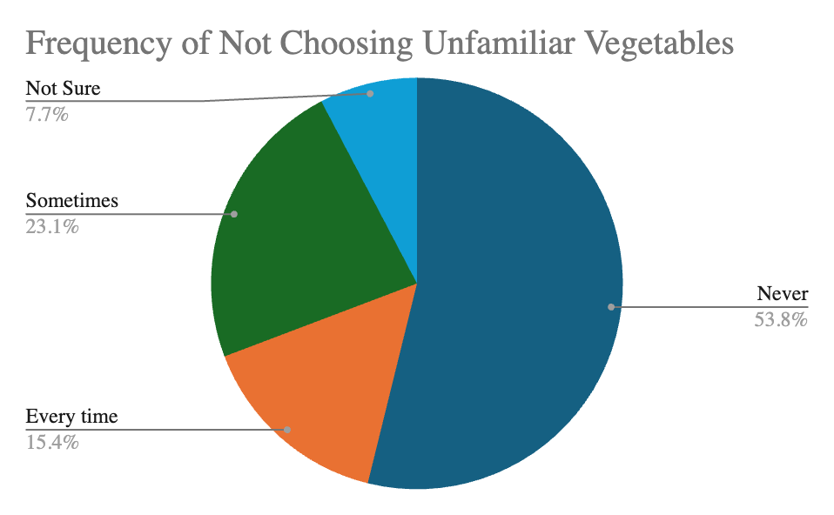
Survey Results
Our hypothesis was that guests skipped over the garden produce they didn’t recognize. But most guests report they do take unfamiliar produce.

Slide 16
Survey Results
Guests were unanimous in their answers to two questions: household size and homelessness. All of the respondents to our survey were housed and lived alone.
Compare that to Cincinnati’s average household size of 2.07 from 2019-2023, per data from the US Census Bureau.
Notes:
https://www.census.gov/quickfacts/fact/table/cincinnaticityohio/HSD310223#HSD310223

Slide 17
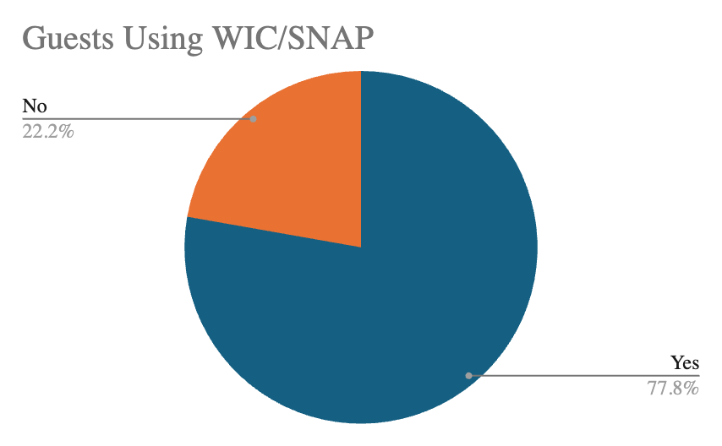
Survey Results
According to data collected by the city of Cincinnati, 41.2% of households in Walnut Hills use SNAP benefits. Unsurprisingly, food insecurity is higher among guests of Open Door Food Pantry.
Notes:
https://www.cincinnati-oh.gov/oes/equity1/climate-equity-indicators/

Slide 18
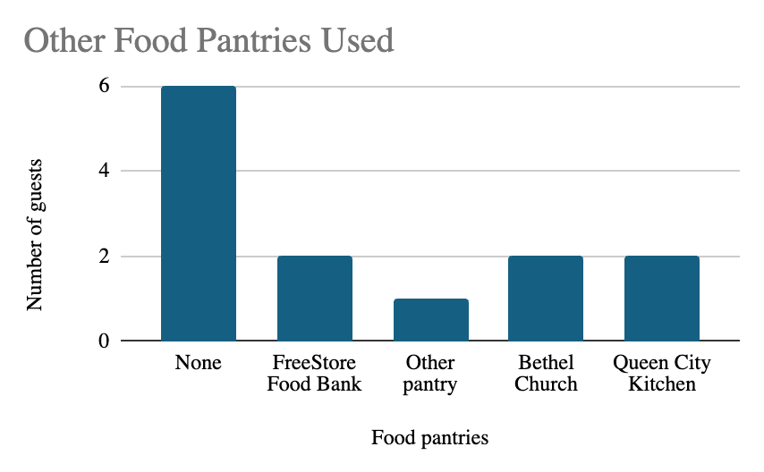
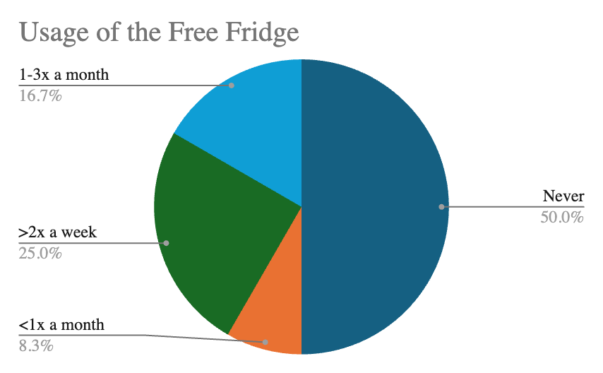
Survey Results
Despite the high rate of food insecurity among food pantry guests, many of those surveyed do not use other food pantries. Half of those surveyed also do not access the Free Fridge on The Advent’s campus.

Slide 19
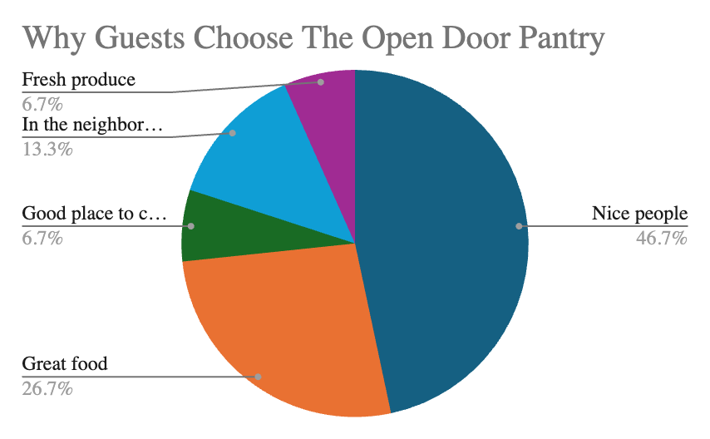
Survey Results
In general, guests choose Open Door for the people (46.7%) and for the quality and selection of food (33.4%).

Slide 20
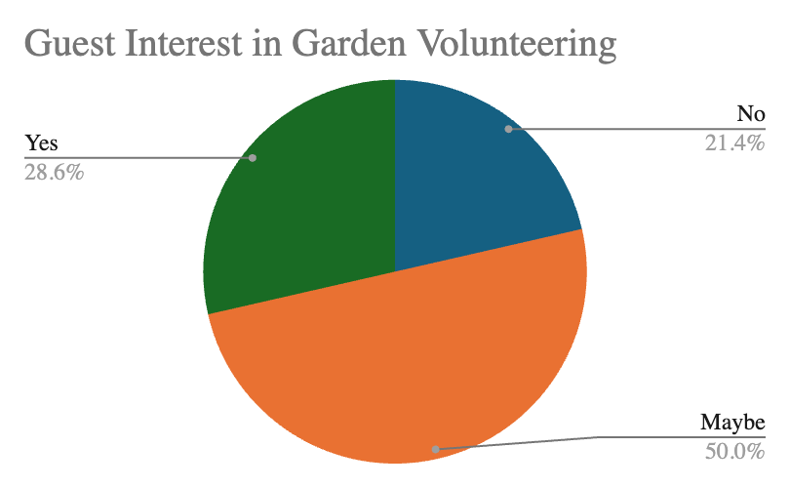
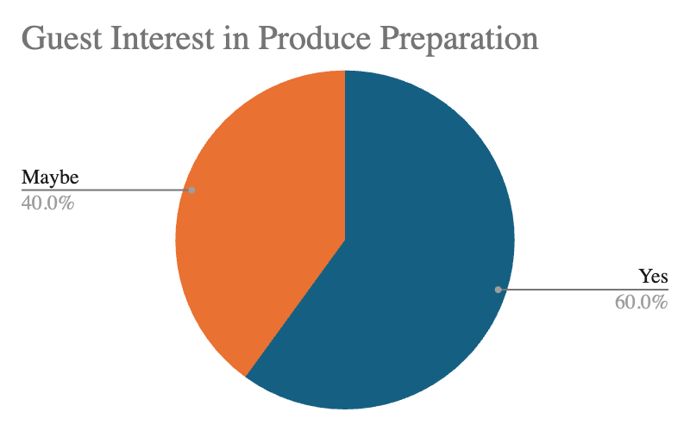
Survey Results
Guests are also open to participating in the growing and preparation of food for Open Door with 78.6% of respondents interested in garden volunteering and 100% of respondents interested in group food prep.

Slide 21
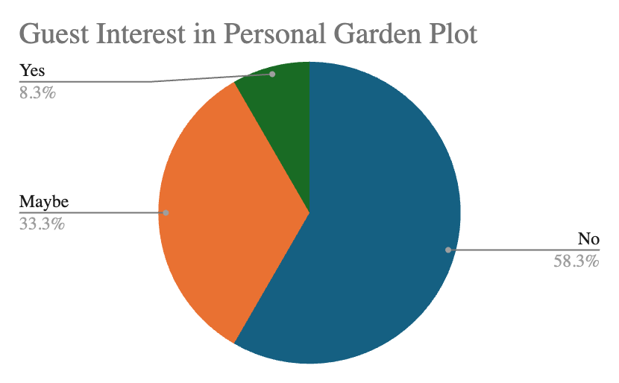
Survey Results
Fewer guests would like to take on a garden plot of their own, with only one guest answering “yes” to that question.

Slide 22

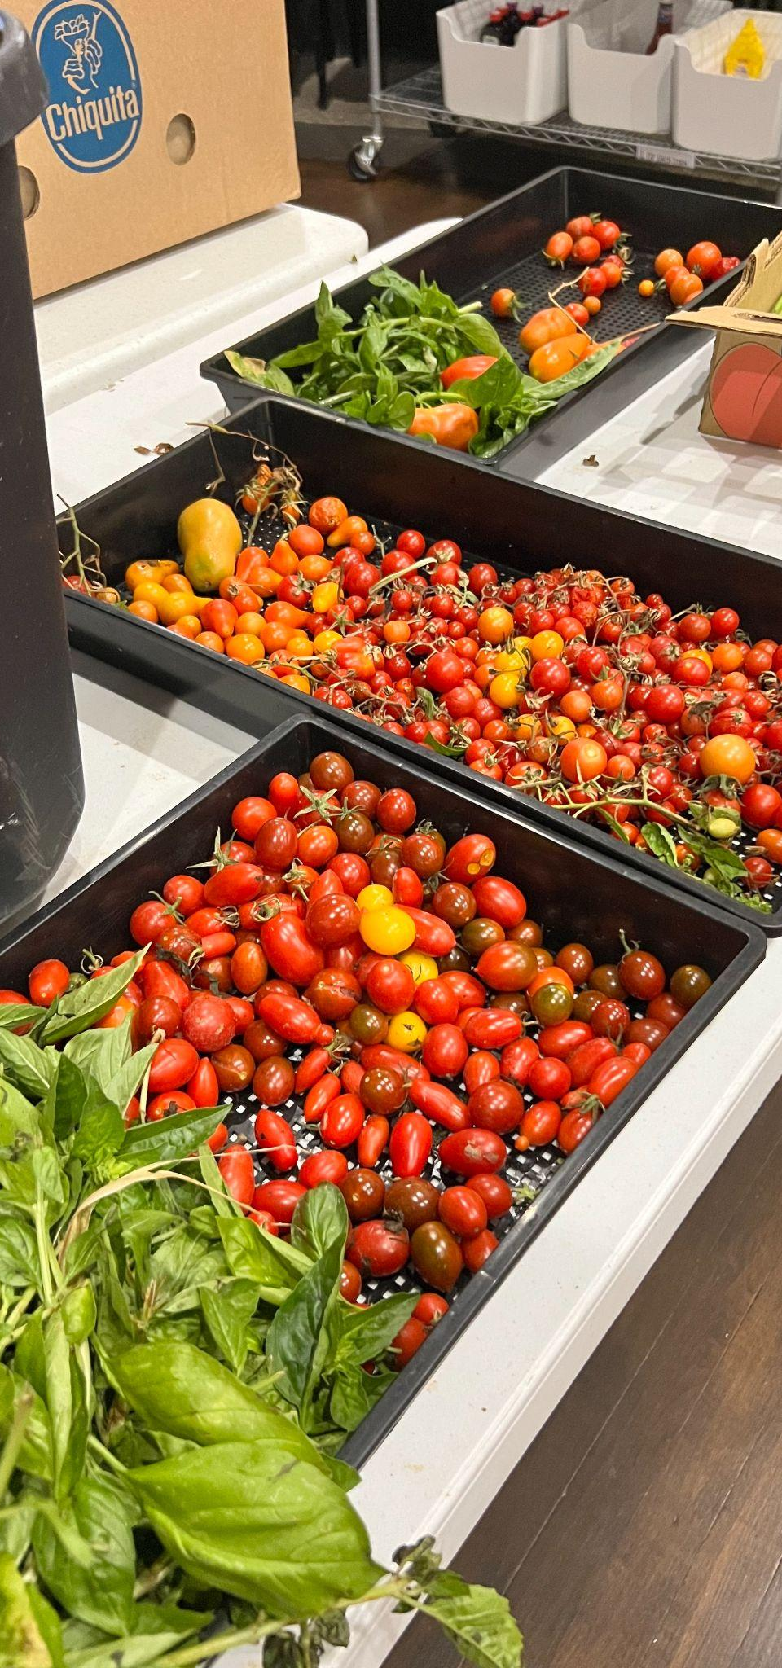
Takeaway #1
While we had initially planned to create recipe cards to help guests feel comfortable choosing unfamiliar produce, the survey suggests that is not as big of an issue as once thought - at least, among those responding to the survey.
Inviting guests to cooking classes and other food prep events may be better received. This could create opportunities to teach healthier meals and cooking techniques.

Slide 23
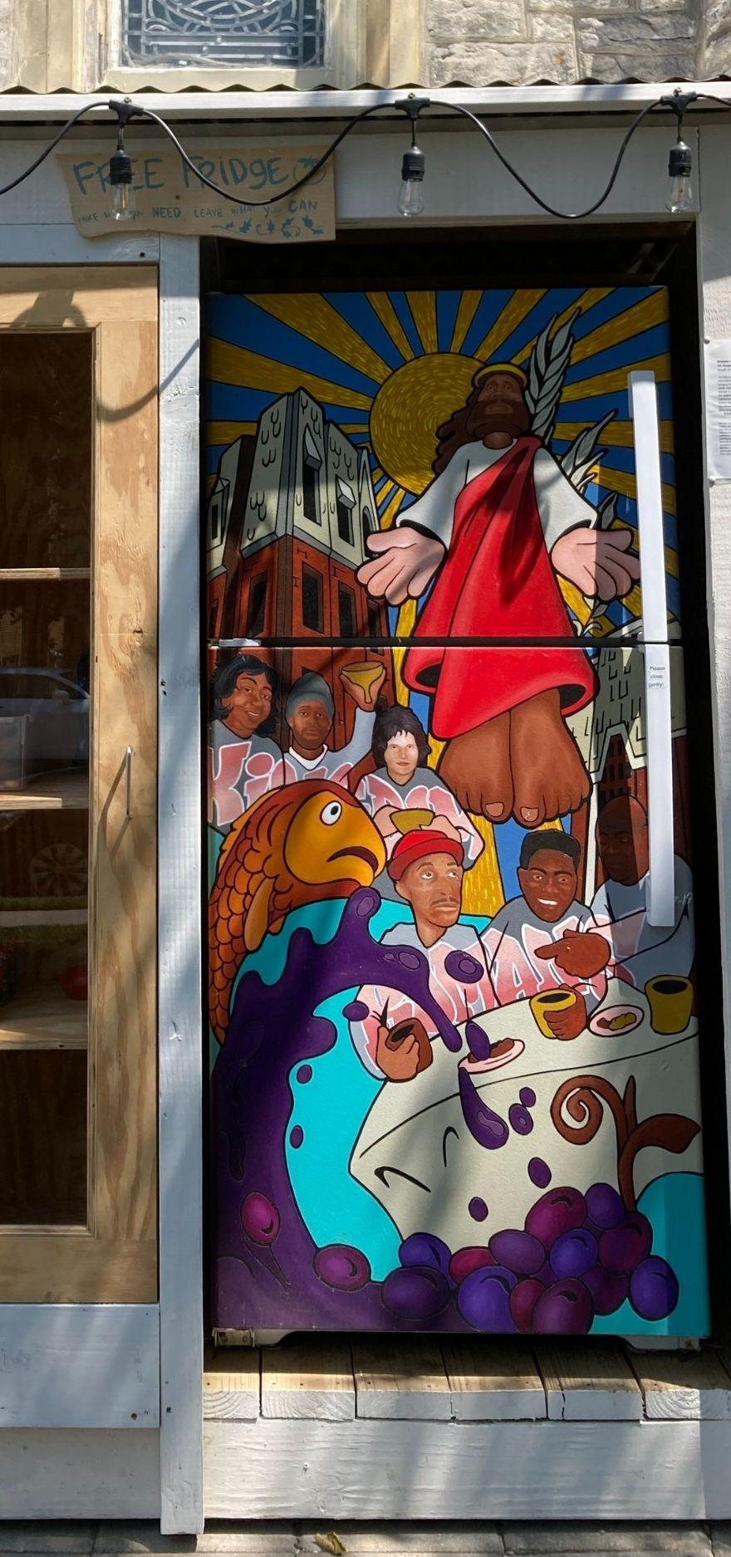
Takeaway #2
There is a lot of opportunity to grow usage of the Open Door Free Fridge.
It is likely that improving awareness of the Free Fridge and improving the frequency of restocking would increase usage both among Open Door guests and other neighbors.

Slide 24
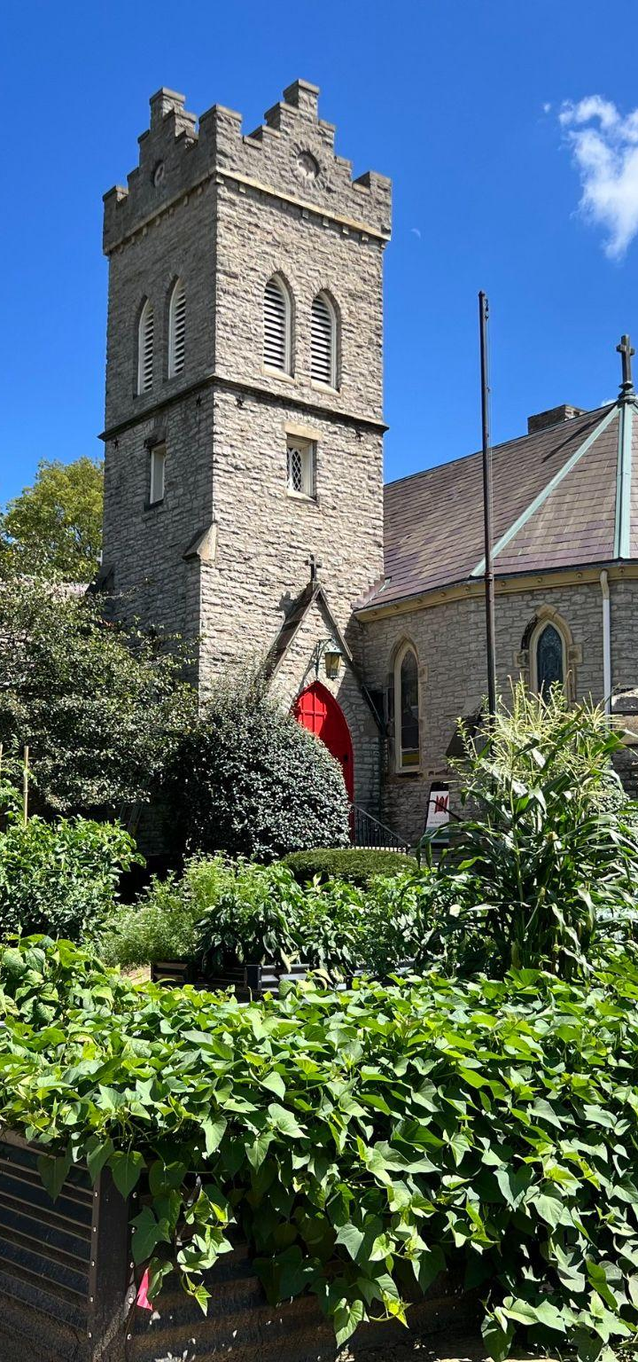
Takeaway #3
All of the surveyed guests reported that they lived alone. This is a risk factor for social isolation.
Guests may choose Open Door Pantry for the social aspect. There is an opportunity to expand social engagement both on pantry days and through community food events, such as food prep or cooking classes.

Slide 25
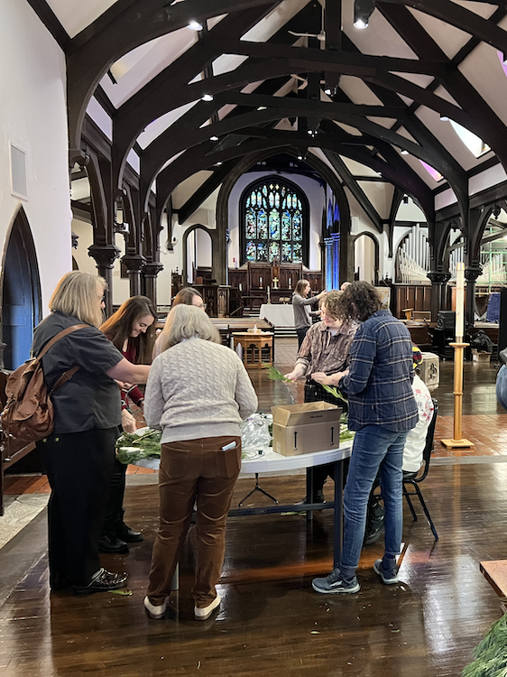
Takeaway #4
In general, Open Door Food Pantry is very well liked by guests. They feel welcomed and are pleased with the food available to them. Any opportunities we’ve identified should not take away from the strong foundation that’s been built.

Slide 26
In Summary
This course allowed me to build on existing relationships in Walnut Hills to:
Deepen my understanding of food insecurity and its impact in this neighborhood.
Support existing efforts to fund and distribute food to neighbors in need.
Strengthen the relationship between UCCOM and the community by engaging with residents and neighborhood leaders in a variety of capacities.
Gain experience in grant writing and data collection.
Get my hands dirty in multiple community gardens.
Notes:
I’m hopeful that through my volunteer work, data collection, and close collaboration with community organizers, I was able to contribute to the vital work being done in that neighborhood. Looking back, this course allowed me to - SLIDE

Slide 27
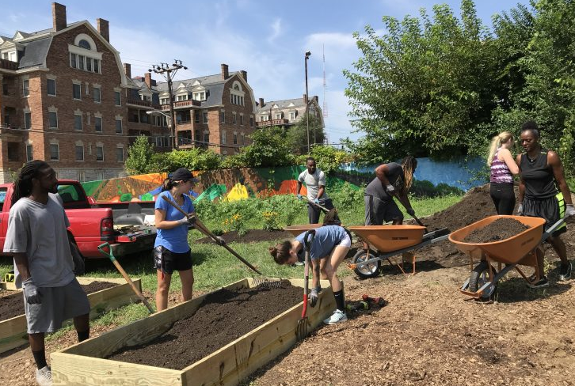
Thank You!
I’m grateful to Mona Jenkins, Gary Dangel, and the Church of the Advent staff, especially Megan Suttman and Junae Roberts. A special thank you to my tireless guide and mentor, Dr. Anna Goroncy of the UC/Christ Family Medicine residency.
Notes:
I owe a big thank you to Mona Jenkins, President of the WHAC and longtime community organizer. Gary Dangel, gardener extraordinaire and a core part of the WHRF. Megan Suttman and Junae Roberts who lead the garden and pantry efforts of the COTA. And Dr. Goroncy, who always has her ear to the ground in Walnut Hills and is a champion both for my education and for ending inequity. And of course to Dan and Dr. Keisler, for creating such an important and impactful course.

